Slide 1
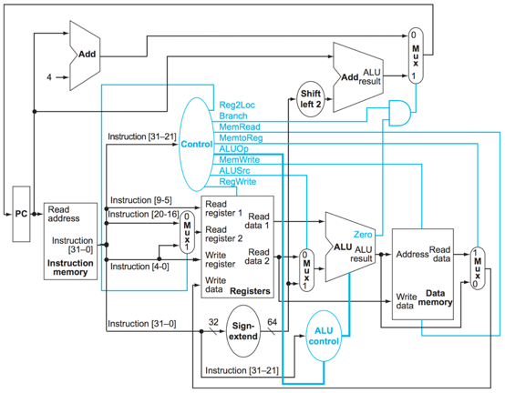
Example Problem 1 Step 1
For an ADD instruction, which elements produce output necessary for execution of the instruction?

Slide 2
Example Problem 1 Step 2
For an ADD instruction, which elements produce output necessary for execution of the instruction?

Slide 3
Example Problem 2 Step 1
For an LDUR instruction, which elements produce output necessary for execution of the instruction?

Slide 4
Example Problem 2 Step 2
For an LDUR instruction, which elements produce output necessary for execution of the instruction?

Slide 5
Example Problem 3 Step 1
For an CBZ instruction, which elements produce output necessary for execution of the instruction?

Slide 6
Example Problem 3 Step 2
For an CBZ instruction, which elements produce output necessary for execution of the instruction?

Slide 7
Example Problem 4 Step 1
Translate -200 to 16 bit twos complement, then to hexadecimal.
200 = 128+64+8 = 0000000011001000
Complement = 1111111100110111
Add 1 = 1111111100111000
Convert to hex
1111 1111 0011 1000 = 0xFF38

Slide 8
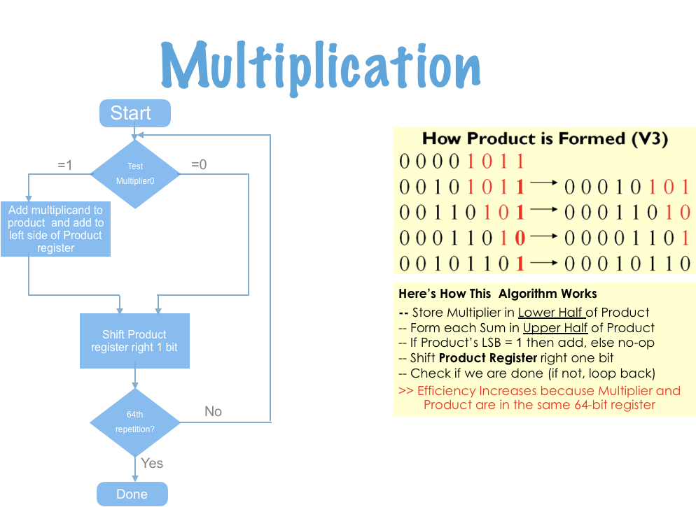
Multiplication

Slide 9
Multiplication problem
Multiply 7 times 6
Iteration | Step | Multiplicand | Product|Multiplier | Action
0 | Initial values | 0111 | 00000110
1 | 1 | 0111 | 00000110 | Lowest bit of Product|Multiplier is 0, do not add multiplicand
 | 2 |  | 00000011 | Shift right
2 | 1 |  | 01110011 | Lowest bit of Product|Multiplier is 1, add multiplicand
 | 2 |  | 00111001 | Shift right
3 | 1 |  | 10101001 | Lowest bit of Product|Multiplier is 1, add multiplicand
 | 2 |  | 01010100 | Shift right
4 | 1 |  | 01010100 | Lowest bit of Product|Multiplier is 0, do not add multiplicand
 | 2 |  | 00101010 | Shift right

Slide 10
Example Problem 5
What number does 0x0C000000 represent if it is a IEEE 754 format floating point number?
0000 1100 0000 0000 0000 0000 0000 0000 0 00011000 00000000000000000000000
Sign 0 Exponent 24-127 = -103 Fraction 0 1.0 x 2⁻¹⁰³ = 7.779 x 10⁻⁶²

Slide 11
Example Problem 6
Express -4.75 in IEEE 754 format
4.75 = 4+0.5+0.25 = 2² + 2⁻¹ + 2⁻²
= 100.11 in binary
100.11 = 1.0011 x 2² normalized
Exponent = 2+127 = 129 = 10000001
Sign = 1 (negative)
Fraction = 00110000000000000000000
Put it together:
1 10000001 00110000000000000000000
1100 0000 1001 1000 0000 0000 0000 0000
0xC0980000

